Slide 1

Database Systems: Design, Implementation, and Management
Tenth Edition
Chapter 13
Business Intelligence and Data Warehouses

Slide 2
Objectives
In this chapter, you will learn:
How business intelligence provides a comprehensive business decision support framework
About business intelligence architecture, its evolution, and reporting styles
About the relationship and differences between operational data and decision support data
What a data warehouse is and how to prepare data for one
Database Systems, 10th Edition

Slide 3
Objectives (cont’d.)
What star schemas are and how they are constructed
About data analytics, data mining, and predictive analytics
About online analytical processing (OLAP)
How SQL extensions are used to support OLAP-type data manipulations
Database Systems, 10th Edition

Slide 4
The Need for Data Analysis
Managers track daily transactions to evaluate how the business is performing
Strategies should be developed to meet organizational goals using operational databases
Data analysis provides information about short-term tactical evaluations and strategies
Database Systems, 10th Edition

Slide 5
Business Intelligence
Comprehensive, cohesive, integrated tools and processes
  Capture, collect, integrate, store, and analyze data
  Generate information to support business decision making
Framework that allows a business to transform:
  Data into information
  Information into knowledge
  Knowledge into wisdom
Database Systems, 10th Edition

Slide 6
Business Intelligence Architecture
Composed of data, people, processes, technology, and management of components
Focuses on strategic and tactical use of information
Key performance indicators (KPI)
  Measurements that assess company’s effectiveness or success in reaching goals
Multiple tools from different vendors can be integrated into a single BI framework
Database Systems, 10th Edition

Slide 7
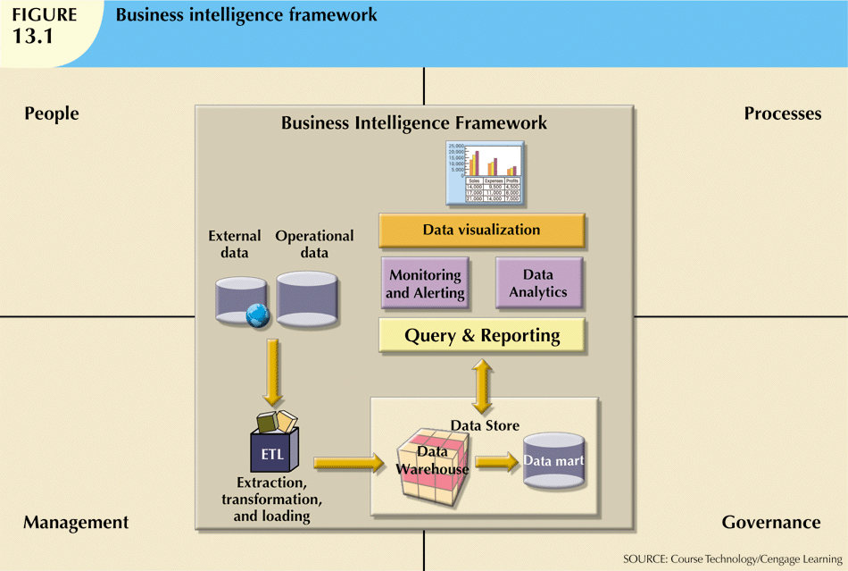
Database Systems, 10th Edition

Slide 8
Business Intelligence Benefits
Main goal: improved decision making
Other benefits
  Integrating architecture
  Common user interface for data reporting and analysis
  Common data repository fosters single version of company data
  Improved organizational performance
Database Systems, 10th Edition

Slide 9
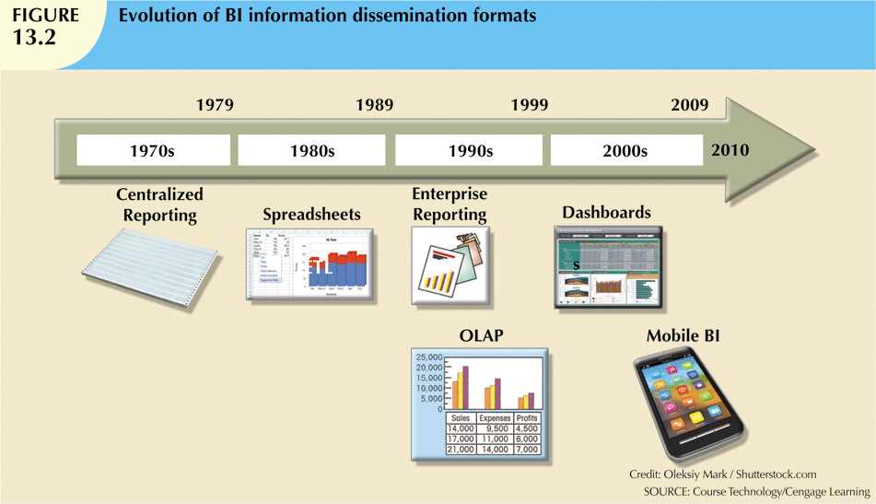
Business Intelligence Evolution
Database Systems, 10th Edition

Slide 10
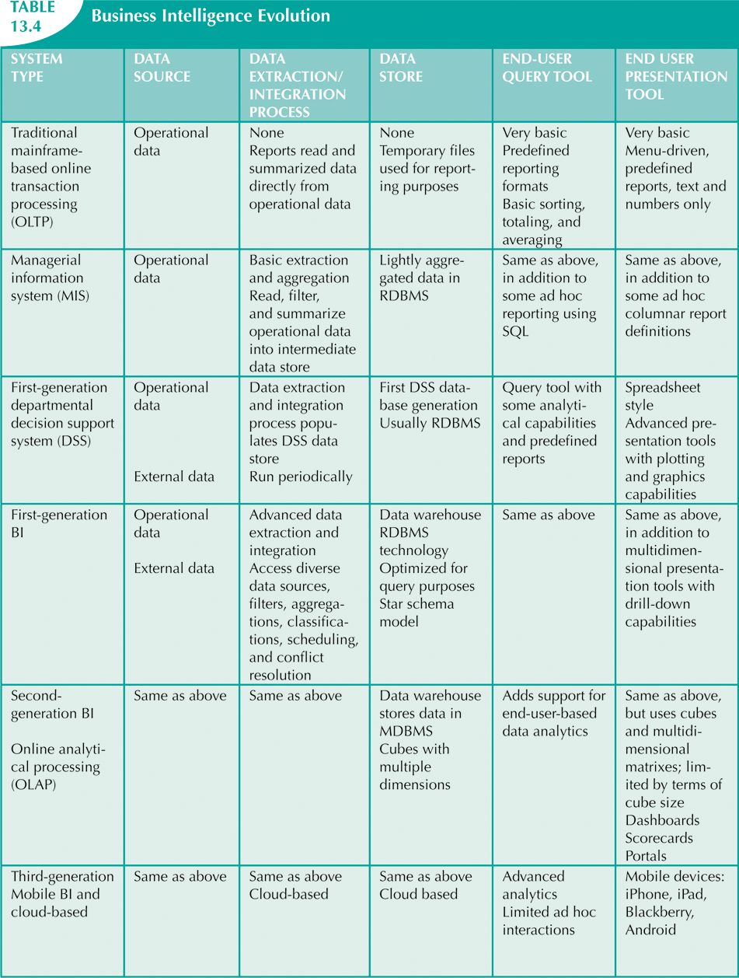
Database Systems, 10th Edition

Slide 11
Business Intelligence Technology Trends
Data storage improvements
Business intelligence appliances
Business intelligence as a service
Big Data analytics
Personal analytics
Database Systems, 10th Edition

Slide 12
Decision Support Data
BI effectiveness depends on quality of data gathered at operational level
Operational data seldom well-suited for decision support tasks
Need reformat data in order to be useful for business intelligence
Database Systems, 10th Edition

Slide 13
Operational Data vs.
Decision Support Data
Operational data
  Mostly stored in relational database
  Optimized to support transactions representing daily operations
Decision support data differs from operational data in three main areas:
  Time span
  Granularity
  Dimensionality
Database Systems, 10th Edition

Slide 14
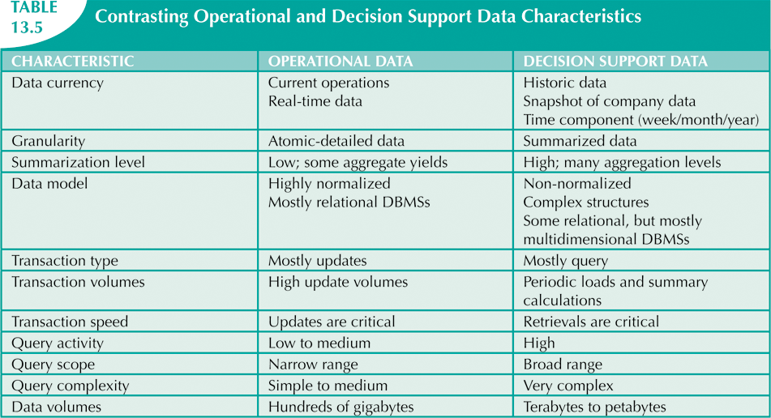
Database Systems, 10th Edition

Slide 15
Decision Support
Database Requirements
Specialized DBMS tailored to provide fast answers to complex queries
Three main requirements
  Database schema
  Data extraction and loading
  Database size
Database Systems, 10th Edition

Slide 16
Decision Support
Database Requirements (cont’d.)
Database schema
  Complex data representations
  Aggregated and summarized data
  Queries extract multidimensional time slices
Data extraction and filtering
  Supports different data sources
    Flat files
    Hierarchical, network, and relational databases
    Multiple vendors
  Checking for inconsistent data
Database Systems, 10th Edition

Slide 17
Decision Support
Database Requirements (cont’d.)
Database size
  In 2005, Wal-Mart had 260 terabytes of data in its data warehouses
  DBMS must support very large databases (VLDBs)
Database Systems, 10th Edition

Slide 18
The Data Warehouse
Integrated, subject-oriented, time-variant, and nonvolatile collection of data
  Provides support for decision making
Usually a read-only database optimized for data analysis and query processing
Requires time, money, and considerable managerial effort to create
Database Systems, 10th Edition

Slide 19
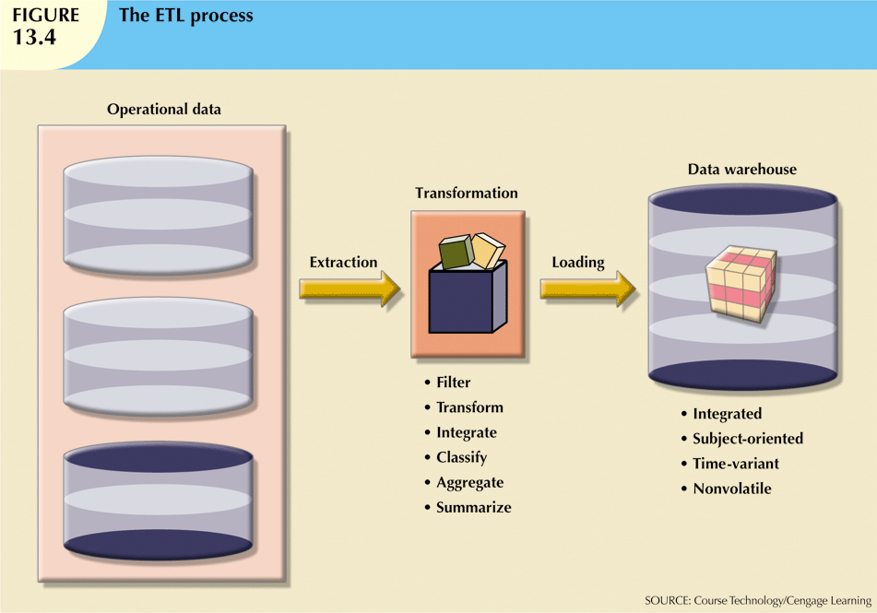
Database Systems, 10th Edition

Slide 20
Data Marts
Small, single-subject data warehouse subset
More manageable data set than data warehouse
Provides decision support to small group of people
Typically lower cost and lower implementation time than data warehouse
Database Systems, 10th Edition

Slide 21
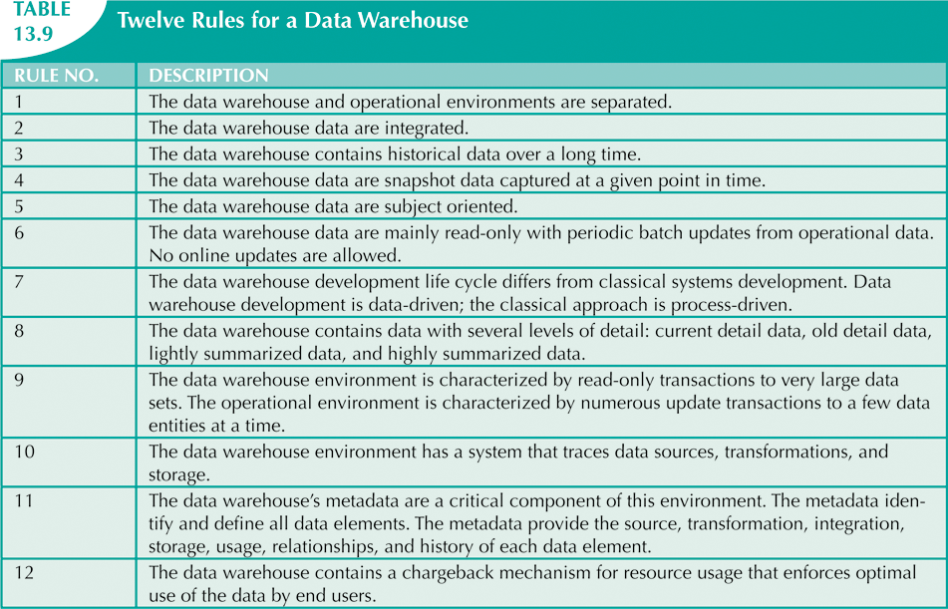
Twelve Rules That Define a Data Warehouse
Database Systems, 10th Edition

Slide 22
Star Schemas
Data-modeling technique
  Maps multidimensional decision support data into relational database
Creates near equivalent of multidimensional database schema from relational data
Easily implemented model for multidimensional data analysis while preserving relational structures
Four components: facts, dimensions, attributes, and attribute hierarchies
Database Systems, 10th Edition

Slide 23
Facts
Numeric measurements that represent specific business aspect or activity
  Normally stored in fact table that is center of star schema
Fact table contains facts linked through their dimensions
Metrics are facts computed at run time
Database Systems, 10th Edition

Slide 24
Dimensions
Qualifying characteristics provide additional perspectives to a given fact
Decision support data almost always viewed in relation to other data
Study facts via dimensions
Dimensions stored in dimension tables
Database Systems, 10th Edition

Slide 25
Attributes
Use to search, filter, and classify facts
Dimensions provide descriptions of facts through their attributes
No mathematical limit to the number of dimensions
Slice and dice: focus on slices of the data cube for more detailed analysis
Database Systems, 10th Edition

Slide 26
Attribute Hierarchies
Provide top-down data organization
Two purposes:
  Aggregation
  Drill-down/roll-up data analysis
Determine how the data are extracted and represented
Stored in the DBMS’s data dictionary
Used by OLAP tool to access warehouse properly
Database Systems, 10th Edition

Slide 27
Star Schema Representation
Facts and dimensions represented in physical tables in data warehouse database
Many fact rows related to each dimension row
  Primary key of fact table is a composite primary key
  Fact table primary key formed by combining foreign keys pointing to dimension tables
Dimension tables are smaller than fact tables
Each dimension record is related to thousands of fact records
Database Systems, 10th Edition

Slide 28
Performance-Improving Techniques for the Star Schema
Four techniques to optimize data warehouse design:
  Normalizing dimensional tables
  Maintaining multiple fact tables to represent different aggregation levels
  Denormalizing fact tables
  Partitioning and replicating tables
Database Systems, 10th Edition

Slide 29
Performance-Improving Techniques for the Star Schema (cont’d.)
Dimension tables normalized to:
  Achieve semantic simplicity
  Facilitate end-user navigation through the dimensions
Denormalizing fact tables improves data access performance and saves data storage space
Partitioning splits table into subsets of rows or columns
Replication makes copy of table and places it in different location
Database Systems, 10th Edition

Slide 30
Data Analytics
Subset of BI functionality
Encompasses a wide range of mathematical, statistical, and modeling techniques
  Purpose of extracting knowledge from data
Tools can be grouped into two separate areas:
  Explanatory analytics
  Predictive analytics
Database Systems, 10th Edition

Slide 31
Data Mining
Data-mining tools do the following:
  Analyze data
  Uncover problems or opportunities hidden in data relationships
  Form computer models based on their findings
  Use models to predict business behavior
Runs in two modes
  Guided
  Automated
Database Systems, 10th Edition

Slide 32
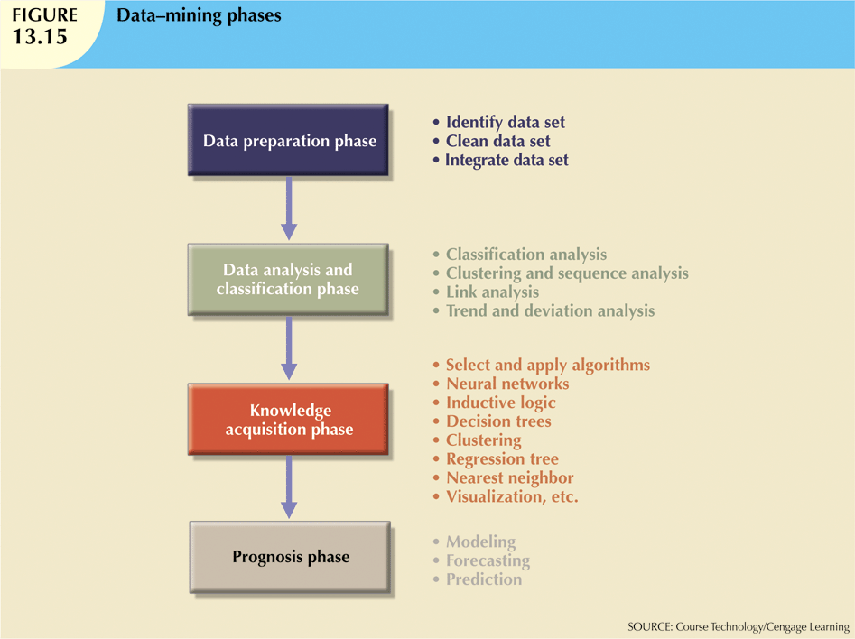
Database Systems, 10th Edition

Slide 33
Predictive Analytics
Employs mathematical and statistical algorithms, neural networks, artificial intelligence, and other advanced modeling tools
Create actionable predictive models based on available data
Models are used in areas such as:
  Customer relationships, customer service, customer retention, fraud detection, targeted marketing, and optimized pricing
Database Systems, 10th Edition

Slide 34
Online Analytical Processing
Three main characteristics:
  Multidimensional data analysis techniques
  Advanced database support
  Easy-to-use end-user interfaces
Database Systems, 10th Edition

Slide 35
Multidimensional Data Analysis Techniques
Data are processed and viewed as part of a multidimensional structure
Augmented by the following functions:
  Advanced data presentation functions
  Advanced data aggregation, consolidation, and classification functions
  Advanced computational functions
  Advanced data modeling functions
Database Systems, 10th Edition

Slide 36
Advanced Database Support
Advanced data access features include:
  Access to many different kinds of DBMSs, flat files, and internal and external data sources
  Access to aggregated data warehouse data
  Advanced data navigation
  Rapid and consistent query response times
  Maps end-user requests to appropriate data source and to proper data access language
  Support for very large databases
Database Systems, 10th Edition

Slide 37
Easy-to-Use End-User Interface
Advanced OLAP features are more useful when access is simple
Many interface features are “borrowed” from previous generations of data analysis tools
  Already familiar to end users
  Makes OLAP easily accepted and readily used
Database Systems, 10th Edition

Slide 38
OLAP Architecture
Three main architectural components:
  Graphical user interface (GUI)
  Analytical processing logic
  Data-processing logic
Database Systems, 10th Edition

Slide 39
OLAP Architecture (cont’d.)
Designed to use both operational and data warehouse data
In most implementations, data warehouse and OLAP are interrelated and complementary
OLAP systems merge data warehouse and data mart approaches
Database Systems, 10th Edition

Slide 40
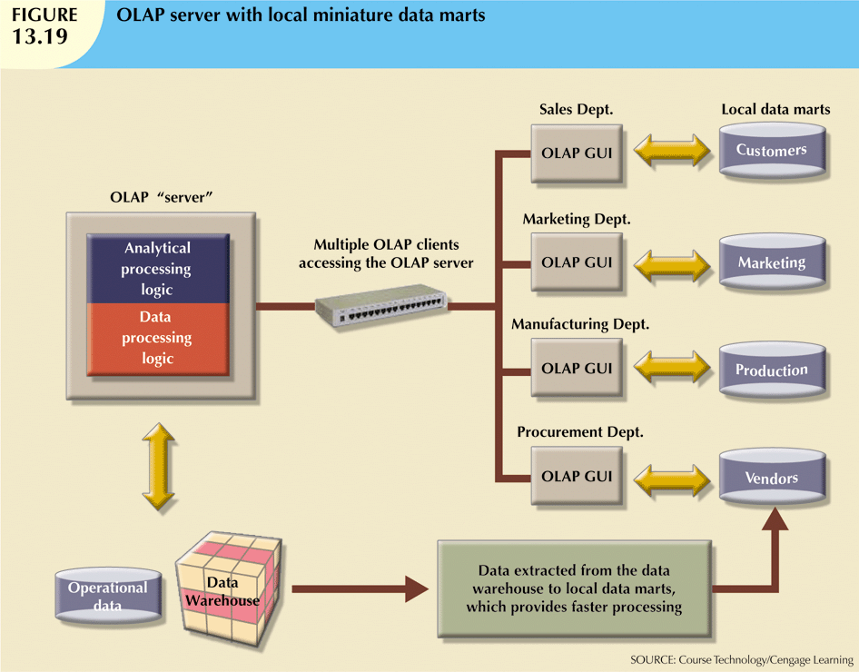
Database Systems, 10th Edition

Slide 41
Relational OLAP
Relational online analytical processing (ROLAP) provides the following extensions:
  Multidimensional data schema support within the RDBMS
  Data access language and query performance optimized for multidimensional data
  Support for very large databases (VLDBs)
Database Systems, 10th Edition

Slide 42
Multidimensional OLAP
Multidimensional online analytical processing (MOLAP) extends OLAP functionality to multidimensional database management systems (MDBMSs)
  MDBMS end users visualize stored data as a 3D data cube
  Data cubes can grow to n dimensions, becoming hypercubes
  To speed access, data cubes are held in memory in a cube cache
Database Systems, 10th Edition

Slide 43
Relational vs. Multidimensional OLAP
Selection of one or the other depends on evaluator’s vantage point
Proper evaluation must include supported hardware, compatibility with DBMS, etc.
ROLAP and MOLAP vendors working toward integration within unified framework
Relational databases use star schema design to handle multidimensional data
Database Systems, 10th Edition

Slide 44
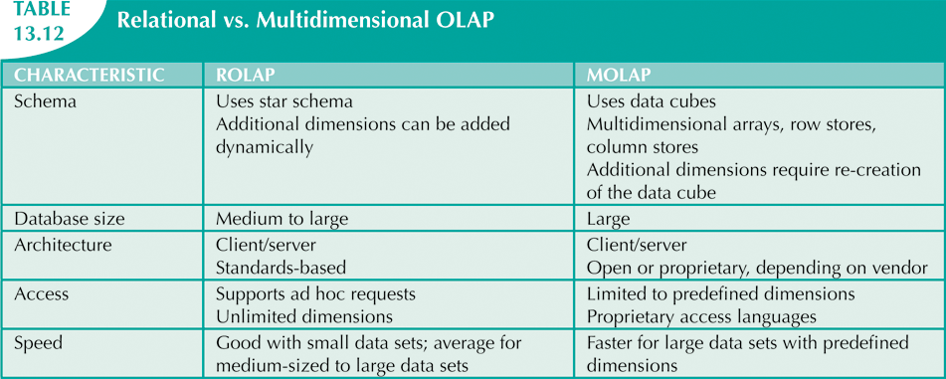
Database Systems, 10th Edition

Slide 45
SQL Extensions for OLAP
Proliferation of OLAP tools fostered development of SQL extensions
Many innovations have become part of standard SQL
All SQL commands will work in data warehouse as expected
Most queries include many data groupings and aggregations over multiple columns
Database Systems, 10th Edition

Slide 46
The ROLLUP Extension
Used with GROUP BY clause to generate aggregates by different dimensions
GROUP BY generates only one aggregate for each new value combination of attributes
ROLLUP extension enables subtotal for each column listed except for the last one
  Last column gets grand total
Order of column list important
Database Systems, 10th Edition

Slide 47
The CUBE Extension
CUBE extension used with GROUP BY clause to generate aggregates by listed columns
  Includes the last column
Enables subtotal for each column in addition to grand total for last column
  Useful when you want to compute all possible subtotals within groupings
Cross-tabulations are good candidates for application of CUBE extension
Database Systems, 10th Edition

Slide 48
Materialized Views
A dynamic table that contains SQL query command to generate rows
  Also contains the actual rows
Created the first time query is run and summary rows are stored in table
Automatically updated when base tables are updated
Database Systems, 10th Edition

Slide 49
Summary
Business intelligence generates information used to support decision making
BI covers a range of technologies, applications, and functionalities
Decision support systems were the precursor of current generation BI systems
Operational data not suited for decision support
Database Systems, 10th Edition

Slide 50
Summary (cont’d.)
Data warehouse provides support for decision making
  Usually read-only
  Optimized for data analysis, query processing
Star schema is a data-modeling technique
  Maps multidimensional decision support data into a relational database
Star schema has four components:
  Facts, dimensions, attributes, and attribute hierarchies
Database Systems, 10th Edition

Slide 51
Summary (cont’d.)
Data analytics
  Provides advanced data analysis tools to extract knowledge from business data
Data mining
  Automates the analysis of operational data to find previously unknown data characteristics, relationships, dependencies, and trends
Predictive analytics
  Uses information generated in the data-mining phase to create advanced predictive models
Database Systems, 10th Edition

Slide 52
Summary (cont’d.)
Online analytical processing (OLAP)
  Advanced data analysis environment that supports decision making, business modeling, and operations research
SQL has been enhanced with extensions that support OLAP-type processing and data generation
Database Systems, 10th Edition

